Slide 1
Staff SIRS Reporting
Monroe Accountability, assessment & Reporting services

Slide 2
Who Gets Reported?
Non-Teaching Professionals
Administrators (principals, directors, coordinators, business officials, superintendents)
Principals
School counselor
Social worker
School Nurse
Speech & language pathologist
OT/PT
Psychologist
Teachers
All teaching staff, including long-term substitute teachers serving as the teacher of record responsible for the course
Short term sub options:
Report sub;
Leave teacher in place;
Report a teacher who is overseeing sub
AIS
Reading Recovery
Library Media Specialist
Special Education
English as a New Language (ENL)

Slide 3
What Gets Reported?
6 Staff-Related SIRS Templates
Staff Snapshot (Districts, BOCES, Charters)
Staff Assignment (Districts, BOCES, Charters)
Staff Attendance (Districts, BOCES, Charters)
Staff Tenure (Districts and BOCES)
Staff Evaluation (Districts and BOCES)
Course Instructor Assignment (Districts, BOCES, Charters)
from Student Management System
Teaching assignment
Teacher linked to course sections

Slide 4
Why Do We Report This Data?
Federal BEDS PMF (Personal Master File) Reporting
Pink and Green Bubble Sheets
Teaching and Non-Teaching Professionals Assignments
Data.nysed.gov
School Report Card
Staff Qualifications
Student and Educator Report
Average class size
Staff Counts
Teacher Turnover Rate
Teacher Attendance Rate
Financial Transparency Report
Staffing Profile

Slide 5
Staff Data in SIRS
Staff Data | Level 0 | SIRS Template | Data Source | SIRS Manual
Who am I? | Staff Snapshot | Staff Snapshot | HR System | Chapter 3: Staff Snapshot Template Data
Where am I? | Staff Snapshot | Staff Snapshot | HR System | Chapter 3: Staff Snapshot Template Data
What is my job assignment? | Non-Teaching Professionals Staff Assignment Teachers Course Instructor Assignment Student Class Entry/Exit | Non-Teaching Professionals Staff Assignment Teachers Course Instructor Assignment Student Class Entry/Exit | Non-Teaching Professionals HR System Teachers SMS | Chapter 3: Staff Assignment Course Instructor Assignment Student Class Entry/Exit
How many school days have I been absent? (Teachers only) | Staff Attendance Staff Attend. Codes | Staff Attendance Attendance Codes | HR Systems | Chapter 3: Staff Attendance
Do I have tenure? (Teachers & Principals only) | Staff Tenure Snapshot | Staff Tenure Snapshot | HR Systems | Chapter 3: Staff Tenure
What is my Evaluation Rating? (Teachers & Principals only) | Staff Evaluation | Staff Evaluation Rating | HR System, or 3rd Party Vendor (Frontline) | Chapter 3: Staff Evaluation Rating Template

Slide 6
Staff Snapshot
All teaching and non-teaching professionals need a Staff Snapshot record
Must have a TEACH ID
Location
If assigned to one specific building, use that building’s location code
If assigned to multiple buildings, use district code “0000”
Years of Experience
Teachers new to a district, charter school, or BOCES should be asked to provide years of prior experience.
LEAs should not be defaulting to 1 for new hires without consideration of prior experience.
Combine all years of professional educational experience, including other public school districts, religious and independent (nonpublic) schools, and BOCES.

Slide 7
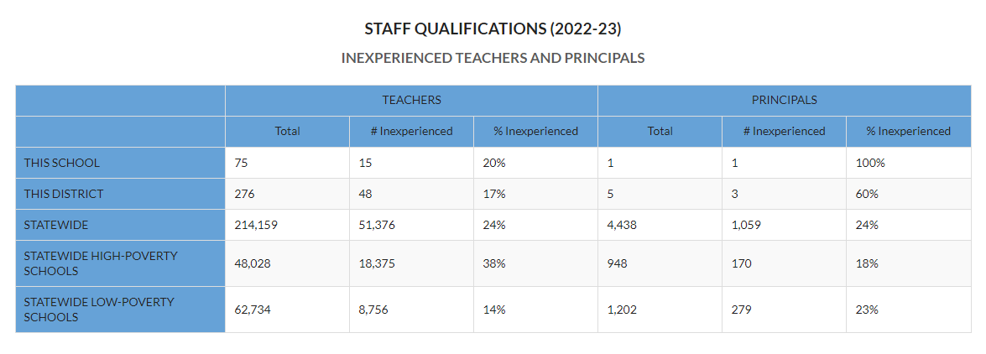
Staff Qualifications Section of School Report Card
Inexperienced Teachers: Teachers with fewer than 4 years of experience as a teacher.
Inexperienced Principals: Principals with fewer than 4 years of experience as a principal.

Slide 8
Itinerant Staff
Itinerant Staff
Itinerant flag allows a district to report a staff person who is teaching students in their district but employed by another LEA.

Slide 9
Examples of Itinerant Teachers Staff Reporting
BOCES Employs Staff Teacher does not teach BOCES courses |  |  | District Does not Employ Staff BOCES Teacher does teach courses in this district
Staff Snapshot (complete) | X | Itinerant, N | Staff Snapshot (fewer fields) | X | Itinerant, Y
Staff Tenure | X |  | Staff Tenure
Staff Evaluation | X |  | Staff Evaluation
Staff Attendance | X |  | Staff Attendance
Course Instructor Assignment |  |  | Course Instructor Assignment | X
Student Class Entry Exit |  |  | Student Class Entry Exit | X
District A or BOCES Employs Staff Teacher does teach courses in this location |  |  | District B Does not Employ Staff District A or BOCES teacher does teach courses in District B as well
Staff Snapshot (complete) | X | Itinerant, N | Staff Snapshot (fewer fields) | X | Itinerant, Y
Staff Tenure | X |  | Staff Tenure
Staff Evaluation | X |  | Staff Evaluation
Staff Attendance | X |  | Staff Attendance
Course Instructor Assignment | X |  | Course Instructor Assignment | X
Student Class Entry Exit | X |  | Student Class Entry Exit | X
District A Employs Staff (50%) |  |  | District B Employs Same Staff from District A (50%)
Staff Snapshot (complete) | X | Itinerant, N | Staff Snapshot (complete) | X | Itinerant, N
Staff Tenure | X |  | Staff Tenure | X
Staff Evaluation | X |  | Staff Evaluation | X
Staff Attendance | X |  | Staff Attendance | X
Course Instructor Assignment | X |  | Course Instructor Assignment | X
Student Class Entry Exit | X |  | Student Class Entry Exit | X

Slide 10
Itinerant Non-Teaching Staff
District A or BOCES Employs Non-Teaching Staff (Professional Counselor, Social Worker…) Not working in District A or BOCES in assignment role |  |  | District B Does not Employ Non-Teaching Staff Professional Counselor, Social Worker, etc. (in-person or via technical connection)
Staff Snapshot (complete) | X | Itinerant, N | Staff Snapshot (fewer fields) | X | Itinerant, Y
Staff Tenure | X | Principal Only | Staff Tenure
Staff Evaluation | X | Principal Only | Staff Evaluation
Staff Assignment |  |  | Staff Assignment | X
District A or BOCES Employs Non-Teaching Staff (Professional Counselor, Social Worker…) Does work in District A or BOCES in assignment role |  |  | District B Does not Employ Non-Teaching Staff Professional Counselor, Social Worker, etc. (in-person or via technical connection)
Staff Snapshot (complete) | X | Itinerant, N | Staff Snapshot (fewer fields) | X | Itinerant, Y
Staff Tenure | X | Principal Only | Staff Tenure
Staff Evaluation | X | Principal Only | Staff Evaluation
Staff Assignment | X |  | Staff Assignment | X

Slide 11
Reporting Non-teaching Professionals

Slide 12
Reporting Non-Teaching Professionals
Staff Snapshot (SIRS-320)
TEACH ID
Principal Title (for principals only)
Primary Location – if more than one building use “0000”
Staff Assignment (SIRS-318)
Assignment Code (see SIRS Manual)
Assignment Location
Grade Level
If principal for all grades in a building, choose “ALL”
Do not use grades “K-6” or “7-12”
If principal for specific grades in a building, report one record for each grade level

Slide 13
Assignment Field & Percent Time Assigned
New Fields for 2024
Assignment Field identifies the type of assignment
In district
Contracted in public
Contracted in private
Contacted out public
Contracted out private
Percent Time Assigned collects the percentage of time the person is assigned such responsibilities in a particular location.
Applies to the following staff…
Staff Assignment Code | Staff Assignment Description
2210 | SCHOOL NURSE-TEACHER
2211 | SCHOOL NURSE (RN)
2212 | LICENSED PRACTICAL NURSE (LPN)
2022 | SCHOOL SOCIAL WORKER
2017 | SCHOOL PSYCHOLOGIST
2117 | SCHOOL COUNSELOR
Only applies to…
Nurses
Social Workers
Psychologists
School Counselors

Slide 14
Code | Definition
In district | Staff person is providing direct services to students int heir own LEA.
Contracted in public | Staff person was contracted from another public LEA to come to this LEA to provide direct services.
Contracted in private | Staff person was contracted from a private entity, not a school district, BOCES, or charter school to come to this LEA to provide direct services.
Contracted out public | Staff person employed in this LEA is contracted to provide direct services to another district, BOCES, or charter school.
Contracted out private | Staff person employed in this LEA is contracted to provide direct services to a nonpublic school.
Scenario | LEA of Employment | Receiving Public LEA where students are served
District, BOCES, or Charter School employed staff working in home district, BOCES, or charter school. | Reports Staff Snapshot record Itinerant = N (No). Reports Staff Assignment record with Assignment Field In district and Percent Time Assigned for each building served. | NA
District, BOCES, or Charter School employed staff working in another school district, BOCES, or charter school. | Reports Staff Snapshot record Itinerant = N (No). Reports Staff Assignment record with Assignment Field Contracted out public and Percent Time Assigned at the district or overall BOCES level code would be 0. | Reports Staff Snapshot record where Itinerant record = Y (Yes). Reports Staff Assignment record with Assignment Field Contracted in public and Percent Time Assigned for each building served.
District or BOCES employed staff working in a nonpublic school | Reports Staff Snapshot record Itinerant = N (No). Reports Staff Assignment record with Assignment Field Contracted out private and Percent Time Assigned at the district level would be 0. | Nonpublic schools do not report Staff Assignment data to the SIRS.
Privately Employed staff working in a district, BOCES, or charter school. | Private entities do not report staff data to the SIRS. | Reports Staff Snapshot record where Itinerant record = Y (Yes). Reports Staff Assignment record with Assignment Field Contracted in private and Percent Time Assigned for each building served.

Slide 15
Student and Educator Report
* There is a plan to add nurses to this report

Slide 16
Reporting Teachers

Slide 17
Reporting Teachers
Staff Snapshot (SIRS-320)
TEACH ID
TEACHER Title
Primary Location – if more than one building use “0000”
Itinerant Staff – “Y” for staff not employed by LEA but responsible for students
BOCES staff not assigned on a permanent or consistent basis to a district should only be reported as BOCES staff.
BOCES staff working in multiple districts may be reported solely by the BOCES.
Include substitutes if serving as the Teacher of Record
Certification Exemption Code - Charter Schools only
Course Instructor Assignment
Teaching Assignment based on State Course Code
Student Class Entry/Exit
Registration - Students in course section

Slide 18
Teacher ePMF Data Flow
HR System
SMS
Student Lite
School Entry/Exit
Course
Course Instructor Assignment
Student Class Entry/Exit
Courses are mapped to state course codes. The SCED Course Crosswalk maps state course codes to certification titles.
Staff Snapshot
Shows the course and course section the teacher is assigned to.
The Staff Snapshot needs to be loaded in Level 0 before Course Instructor Assignment and Student Class Entry/Exit
The # of students in each course section.

Slide 19
Course Template
Maps the courses in your student management system to State Course Codes
Must be imported into Level 0 before Course Instructor Assignment & Student Class Entry/Exit templates
If you change the State Course Code for a course, you must import the Course template into Level 0 again
State course codes are mapped to specific teacher certification areas

Slide 20
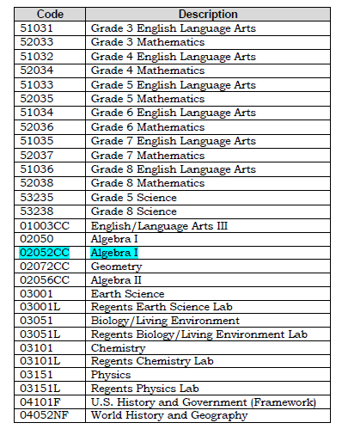
Courses Ending in State Exams
Exceptions: If the course is an AP or IB course that ends in a Regents exam, use the correct AP or IB Course Code for the course.

Slide 21
NYS Comprehensive Course Catalog
http://www.p12.nysed.gov/irs/courseCatalog/home.html

Slide 22
Course Instructor Assignment Template
Contains Teaching Assignment information for each teacher
Course and Course Sections
Who is included
All staff reported with TEACHER title in Staff Snapshot
Daily subs do not need to be reported UNLESS they are the teacher of record/primary teacher of the course

Slide 23
Elements of Course Instructor Assignment | Reason
Course Location | School building/location of assignment
Local Course Code | Teaching Assignment
Section Code | Teaching Assignment
Instructor TEACH ID | Who is the teacher
Instructor Start Date | How long they taught
Instructor End Date | How long they taught
Primary Instructor Indicator | Role of teacher in class
Primary Special Education Indicator | Role of teacher in class
Primary ENL Instructor Indicator | Role of teacher in class
Incidental Teaching Assignment Indicator | Teaching out of certification
Primary Instruction Delivery Method | Face-to-Face, Distance Learning, Blended, Online
Primary Course Instruction Language | Primary language for providing instruction in course

Slide 24
Instructor Indicators
Role (Y/N) | Description
Primary Instructor Indicator (Required) | Teacher has primary responsibility for the course content (classroom teacher)
Primary Special Education Indicator | Special education teacher for the course Special education teachers that push-in to classes to provide services If special education teacher is also the primary teacher or a co-teacher, then you would also give them the primary instructor indicator
Primary ENL Instructor Indicator | The English as a New Language teacher for the course ENL teachers that push-in to classes to provide services If the ENL teacher is also the primary teacher or a co-teacher, then you would also give them the primary instructor indicator
Role
If ENL or Sp. Ed. teacher is pulling students from classes for services, then a separate course and roster is needed
ENL – 51008 (K-6) or 01008 (7-12)
Resource – 99004 (K-6) or 99005 (7-12)
All indicators are subject to certification matches

Slide 25
Incidental Teaching Assignment Indicator (Districts and BOCES only)
Teachers can be assigned to teach classes outside of their certification (Y/N)
A superintendent of schools may assign certified teachers to teach a subject not covered by their certificate (incidental teaching) for a period not to exceed ten classroom hours a week during the 2023-2024 school year, when no certified or qualified teacher is available after extensive and documented recruitment.
BOCES Superintendent reviews and approves the requests for incidental teaching.
https://www.highered.nysed.gov/tcert/resteachers/employmentissues.html#incidental
Identifying Incidental Teaching Assignments
Report your data to L2RPT
Run SIRS-328 Out of Certification Report using Certified Status is “No”
Decide if any of the teaching assignments are incidental
Complete form and submit to BOCES for superintendent approval
Add Incidental Teacher Assignment Indicator in SMS
Report your data to L2RPT again (refreshes nightly)

Slide 26
SIRS-328 Out of Certification Report

Slide 27
Student Class Entry/Exit
Contains Course Roster information
# of students in each course section
Who is included
All students in every course
Also include students where the school has “Instructional Reporting” only responsibilities (0055 enrollment)
Non-district students in BOCES Classrooms located in district school buildings
BOCES reports the students in the BOCES courses
District reports the students in specials (art, music, PE, etc)
A student placed in your district by another district

Slide 28
Elements of Student Class Entry/Exit | Reason
Course Location | School building/location of course
Local Course Code | Teaching Assignment
Section Code | Teaching Assignment
Student ID | Who is the student
Class Entry Date | When student enrolled in class
Class Exit Date | When student dropped the class or class ended
Dual/Concurrent Credit Indicator | Indicates student can earn both high school and college credit for the course

Slide 29
Student Class Entry/Exit Record

Slide 30
L2RPT Reports
State Data Warehouse
Provides LEAs with access to verification reports
This year BEDS data will be certified in L2RPT along with all the other End of Year data
Timeline
Feb 1 - data pulled for Out of Cert. Reports
May 14 – pull CIA and SCEE for USDOE
Aug 19 – EOY data due

Slide 31
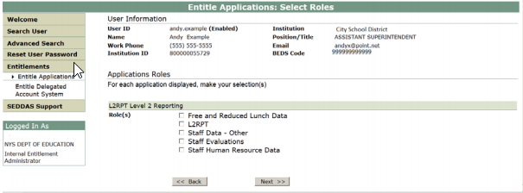
SEDDAS Entitlements to L2RPT
SEDDAS User Guide: http://www.p12.nysed.gov/seddas/seddashome.html

Slide 32
SIRS-320 Staff Snapshot Verification Report

Slide 33
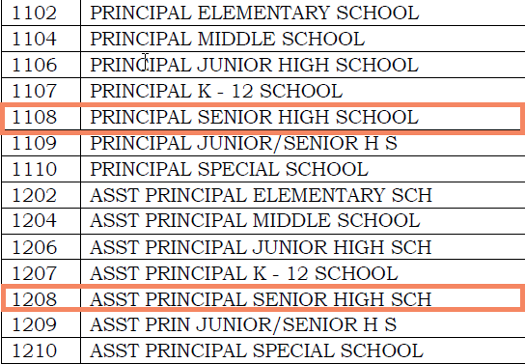
SIRS-318 Staff Assignment Verification Report
Non-Teaching Professional Assignment Codes

Slide 34
SIRS-328 Out of Certification Report

Slide 35
SIRS-329 Staff Certification Report
SIRS-328 Out of Certification Report

Slide 36
Teacher Course To Certification Crosswalk
Maps all state course codes in the NYS Comprehensive Course Catalog to appropriate certification areas in TEACH system
Posted on the IRS Business Portal

Slide 37
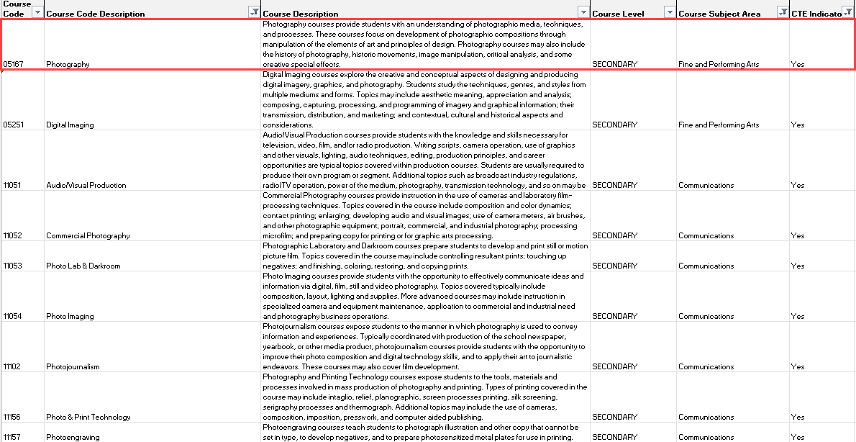

Slide 38
Reporting Tips
Librarians
Need a CIA record, but NYSED does not expect a SCEE record for that course and section
Can use course code 99000
Elementary Teachers
Continue to report separate ELA, Math, Science and Social Studies courses for common branch elementary teachers for grades that take state tests
AP and IB Courses
Be sure to use AP and IB course codes even if students plan to sit for a Regents exam as well
Self-Contained Sp. Ed. Classes
For NYSAA student courses, you can report the following
99001 – Self-Contained - Pre-school
99002 – Self-Contained – K-6 Elementary
99003 – Self-Contained – 7-12 Secondary
99007 – Self-Contained ALL Ungraded
AIS K-6
51996- Eng Lang & Lit- Supplemental
52996- Mathematics- Supplemental
53996- Life & Phys Sci- Supplemental
54996- Social Sci & Hist- Supplemental
AIS 7-12
01996- Eng Lang & Lit- Supplemental
02996- Mathematics- Supplemental
03996- Life & Phys Sci- Supplemental
04996- Social Sci & Hist- Supplemental
How should two-year AP history courses be reported?
If students are enrolled in the course for two years, it should be reported as such

Slide 39
Staff Qualifications Section of School Report Card

Slide 40
SIRS Data Due Dates
Final Out of Certification data due: Thursday, May 16
Staff Evaluation Collection opens: Monday, July 1
Final SIRS EOY data due: Thursday, August 15
Staff Evaluation data due: Thursday, October 17

Slide 41
Resources
SIRS Manual: http://www.p12.nysed.gov/irs/sirs/
NYS Comprehensive Course Catalog: http://www.p12.nysed.gov/irs/courseCatalog/home.html
SEDDAS User Guide: http://www.p12.nysed.gov/seddas/seddashome.html
L2RPT: https://dwdataview.wnyric.org/
Teacher Course to Certification Crosswalk: https://portal.nysed.gov/

Slide 42
Questions?

